Slide 1
5. Principal Component Analysis: Conventional, Application
Conventional PCA criterion and method ; its relation to that SVD based.
Applications:
Hidden factor
Visualization
Latent Semantic Indexing (LSI)
Home Assignment 4
Notes:
Mention that it is based on a model; usually considered a purely heuristic, thus much attractive; yet the model may be perceived as overly simplistic (a few did and rejected it). I still think that telling the truth is better than hiding it.

Slide 2
5. Principal Component Analysis PCA methodology: Summary
* =
Principal component is a rescaled singular triplet
Principal components optimally approximate the data according to the least squares criterion
Principal components are orthogonal to each other
Principal component’s contribution is proportional to its squared singular value
Principal components change at any data transformation, centering included
Principal components of X are highly related to eigenvalues and eigenvectors of A=X′X

Slide 3
5. Principal Component Analysis: Conventional approach, 1
* =
Conventional definition:
Given a data matrix X, first principal component (PC):
a weighted combination z of X features after centering, that is, z=Y*c,
that has the maximum variance with respect to all normed c
Second PC is defined similarly except for a condition that it must be orthogonal to the First PC; Third PC must be orthogonal to both first and second PCs, etc.

Slide 4
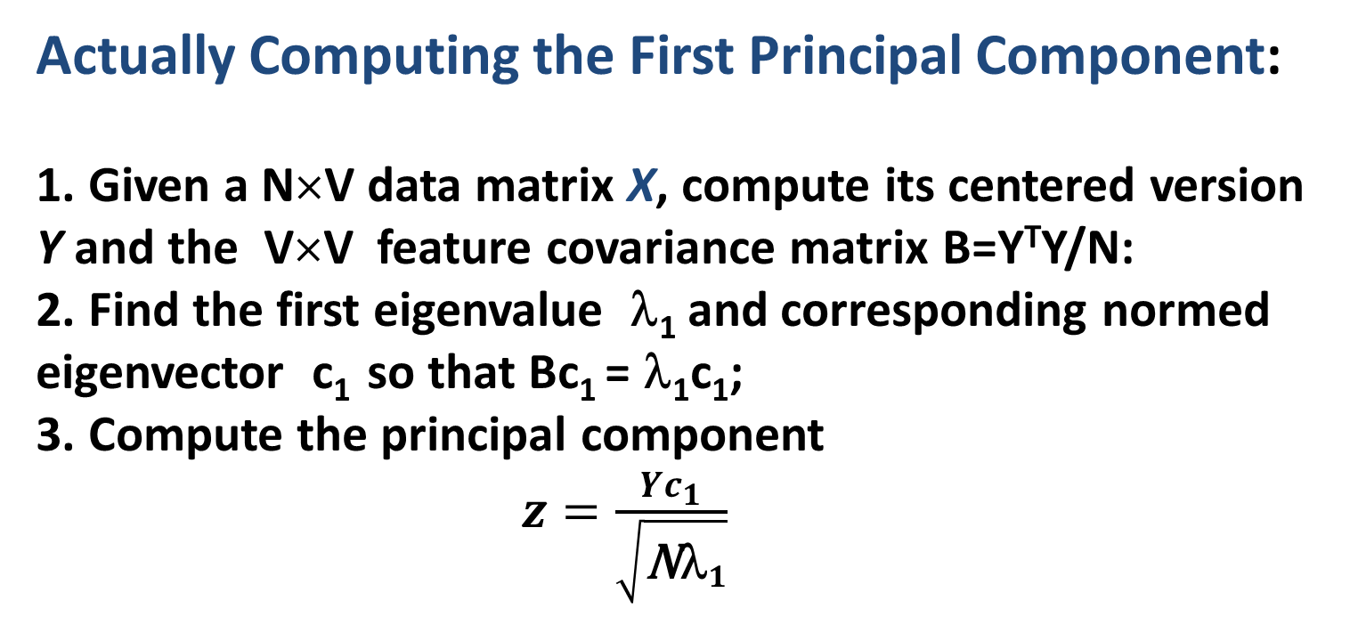
5. Principal Component Analysis: Conventional approach, 2
* =
Actually Computing the First Principal Component:
1. Given a N×V data matrix X, compute its centered version Y and the V×V feature covariance matrix B=Y^{T}Y/N:
2. Find the first eigenvalue λ₁ and corresponding normed eigenvector c₁ so that Bc₁ = λ₁c₁;
3. Compute the principal component
$z=\frac{Yc_{1}}{\sqrt{{\text{N}\text{λ}}_{1}}}$
The 2nd PC is computed in the same way based on a residual covariance matrix Ḃ=B- λ₁c₁c₁′ , etc.

Slide 5
5. Principal Component Analysis: Conventional approach, 3
* =
Covariance matrix:
Given a N×V data matrix X, compute its centered version Y and the V×V feature covariance matrix B:
Center matrix X by finding, for each feature, its mean and subtracting it from all the feature values, Y=X-m(X)
Compute square matrix A=Y′∗Y and divide it by N or N-1 (do the latter if you think that the result is going to be used as an estimate of the covariance matrix of a multivariate density function, I rather divide by N): B= Y′∗Y/N.
(v,w) entry in B: $b_{vw}=\frac{1}{N}\sum_{i=1}^{N}{(x_{iv}−\overline{x_{v}})(x_{iw}−\overline{x_{w}})}$

Slide 6
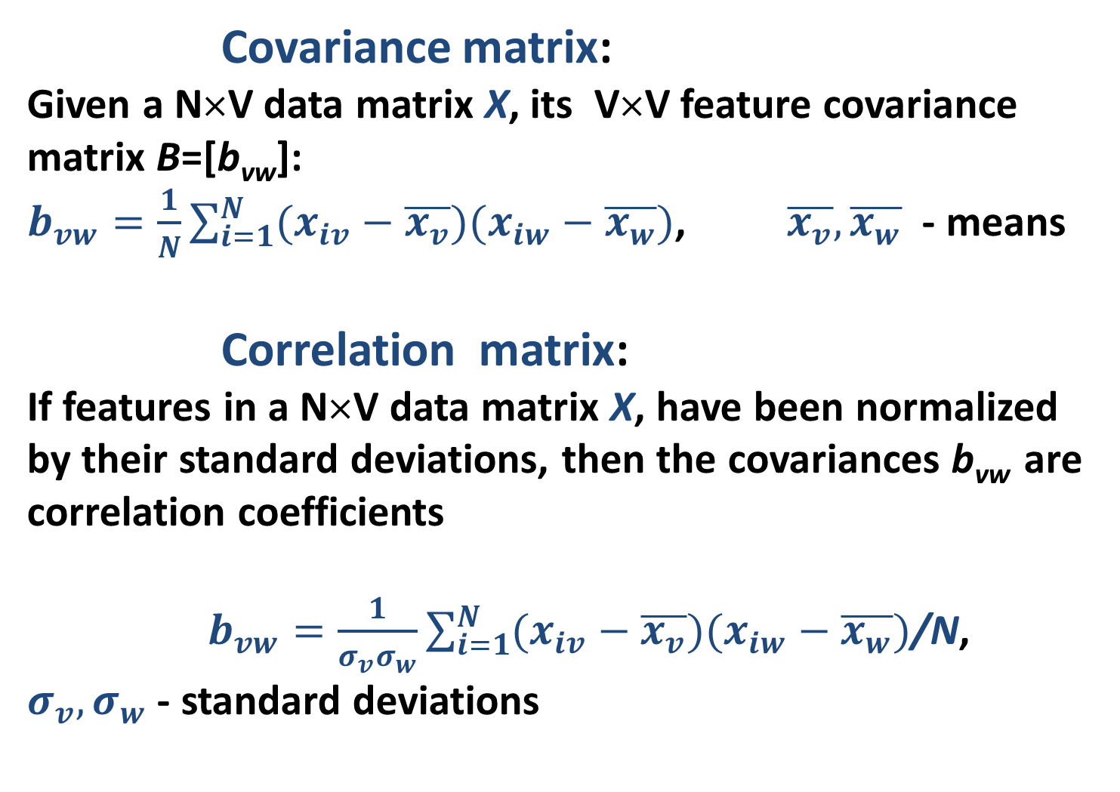
5. Principal Component Analysis: Conventional approach, 4
* =
Covariance matrix:
Given a N×V data matrix X, its V×V feature covariance matrix B=[b_{vw}]:
$b_{vw}=\frac{1}{N}\sum_{i=1}^{N}{(x_{iv}−\overline{x_{v}})(x_{iw}−\overline{x_{w}})}$, $\overline{x_{v}},\overline{x_{w}}$ - means
Correlation matrix:
If features in a N×V data matrix X, have been normalized by their standard deviations, then the covariances b_{vw} are correlation coefficients
$b_{vw}=\frac{1}{σ_{v}σ_{w}}\sum_{i=1}^{N}{(x_{iv}−\overline{x_{v}})(x_{iw}−\overline{x_{w}})}$/N,
$σ_{v}{, σ}_{w}$ - standard deviations

Slide 7
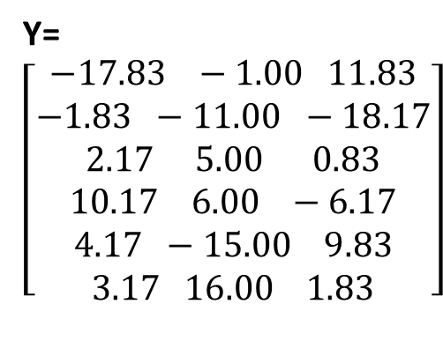
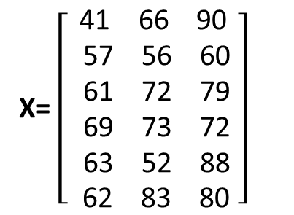
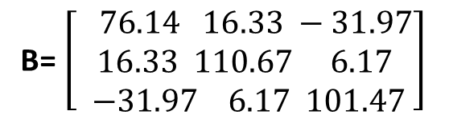
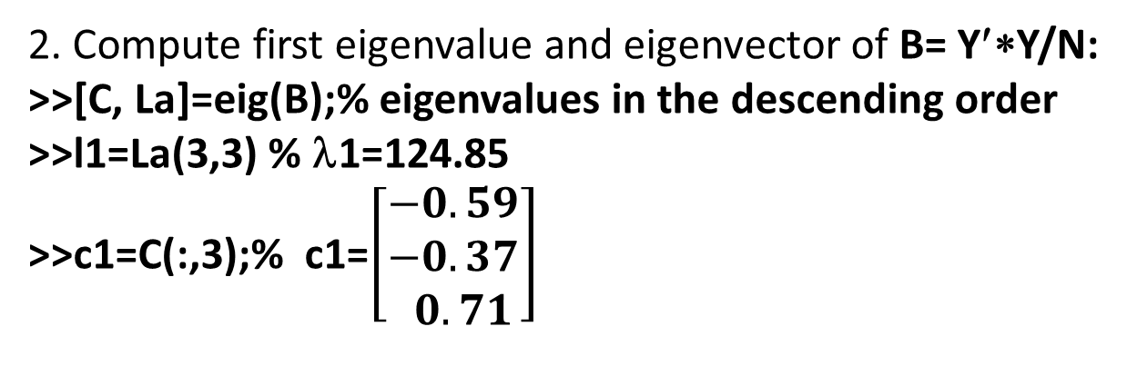
5. Principal Component Analysis: Conventional approach, 5 Example
* =
1. Given X and its centered version Y,
compute the covariance matrix B= Y′∗Y/N.
X= $\left[\begin{aligned}\text{41 66 90} \\ \text{ 57 56 60} \\ \text{ 61 72 79} \\ \text{ 69 73 72} \\ \text{ 63 52 88} \\ \text{ 62 83 80} \end{aligned}\right]$
B= $\left[\begin{aligned} 76.14 16.33 −31.97 \\ 16.33 110.67 6.17 \\ −31.97 6.17 101.47\end{aligned}\right]$
2. Compute first eigenvalue and eigenvector of B= Y′∗Y/N:
>>[C, La]=eig(B);% eigenvalues in the descending order
>>l1=La(3,3) % λ1=124.85
>>c1=C(:,3);% c1=$\left[\begin{aligned}−0.59 \\ −0.37 \\ 0.71\end{aligned}\right]$

Slide 8
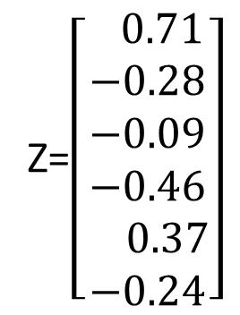
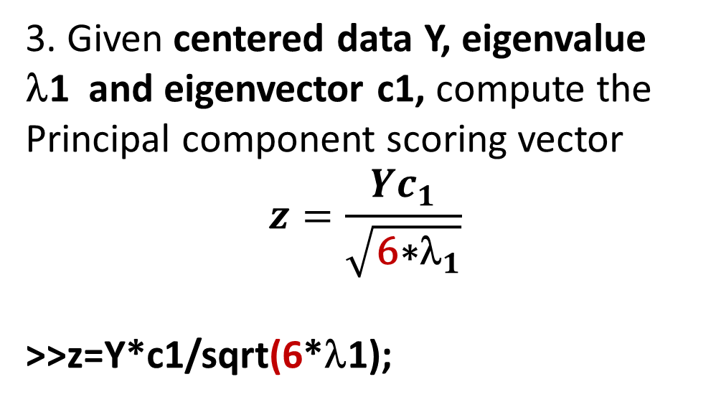
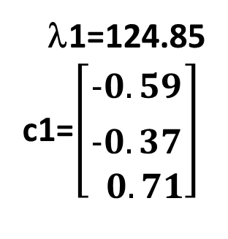
5. Principal Component Analysis: Conventional approach, 6 Example
* =
λ1=124.85
c1=$\left[\begin{aligned}−0.59 \\ −0.37 \\ 0.71\end{aligned}\right]$
3. Given centered data Y, eigenvalue λ1 and eigenvector c1, compute the Principal component scoring vector
$$z=\frac{Yc_{1}}{\sqrt{{\text{6}\text{∗}\text{λ}}_{1}}}$$
>>z=Y*c1/sqrt(6*λ1);
Z=$\left[\begin{aligned} 0.71 \\ −0.28 \\ −0.09 \\ −0.46 \\ 0.37 \\ −0.24\end{aligned}\right]$

Slide 9
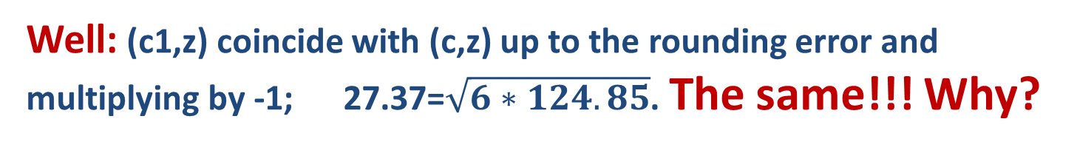
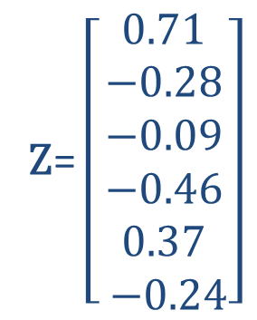
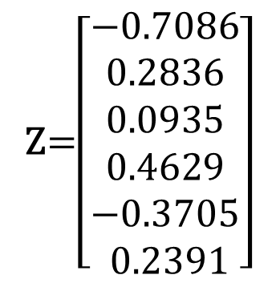
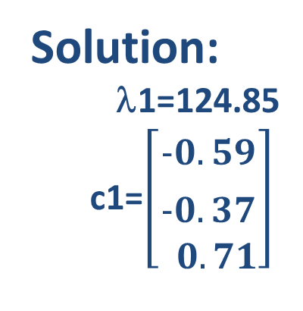
5. Principal Component Analysis: Conventional approach, 7 Example
* =
Solution:
λ1=124.85
c1=$\left[\begin{aligned}−0.59 \\ −0.37 \\ 0.71\end{aligned}\right]$
Z$\text{=}\left[\begin{aligned}0.71 \\ −0.28 \\ −0.09 \\ −0.46 \\ 0.37 \\ −0.24\end{aligned}\right]$
Compare to the solution found using the model-based approach:
μ= 27.37
0.5933
C= 0.3734
-0.7131
Z=$\left[\begin{aligned}−0.7086 \\ 0.2836 \\ 0.0935 \\ 0.4629 \\ −0.3705 \\ 0.2391\end{aligned}\right]$
Well: (c1,z) coincide with (c,z) up to the rounding error and
multiplying by -1; 27.37=$\sqrt{6∗124.85}$. The same!!! Why?

Slide 10
5. Principal Component A: Conventional approach, 8 Relation to that SVD based
* =
Why leads the conventional PCA approach to the same scoring and loading vectors as the model-based PCA?
The former operates over the covariance matrix never used by the latter.
Explanation:
covariance matrix coincides, up to a constant factor, with matrix A=X′∗X, provided that X is centered. Matrix A is in the core of Singular triplets.
Working with eigenvectors of A is equivalent to working with singular vectors of X.

Slide 11
5. Difference between Model-Based (MB) and Conventional approaches
* =
MB PCA models data; Conventional is heuristic
MB PCA derives PCA scoring is a weighted sum of the features; Conventional PCA presumes that
MB PCA applies to any data-preprocessing option; Conventional PCA needs features centered
MB PCA gives contributions to the data scatter; Conventional PCA does not
MB PCA approximates data by a low rank space in which a further search for a “base of simple structure” is possible; Conventional PCA can use only bases of eigenvectors

Slide 12
5. Table of Differences between Model-Based (MB) and Conventional approaches
* =
Feature of PCA | Model Based | Conventional
Relation to data | model | heuristic
Weighted sum of features | derived | presumed
Data-preprocessing | any | centered data
Contributions to data scatter | yes | no
Search for a base of “simple structure” | possible | only eigen-vectors

Slide 13
5. Principal Component Analysis: Applications
Application of PCA to finding a hidden factor
Application of PCA to data visualization
Application of PCA to Dimension reduction (at the case of so-called Latent semantic indexing [LSI] in text analysis).
Notes:
Mention that it is based on a model; usually considered a purely heuristic, thus much attractive; yet the model may be perceived as overly simplistic (a few did and rejected it). I still think that telling the truth is better than hiding it.

Slide 14
5. Principal Component Analysis: Application 1: Hidden factor, 1
Typical problems of scoring according to unmeasurable features:
Measuring student talent
Measuring manager performances
Evaluation of regional wellbeing
Ranking countries over life satisfaction
Notes:
Mention that it is based on a model; usually considered a purely heuristic, thus much attractive; yet the model may be perceived as overly simplistic (a few did and rejected it). I still think that telling the truth is better than hiding it.

Slide 15
Week 5. Principal Component Analysis: Application 1: Hidden factor, 2
Ranking individuals over life satisfaction:
Principal component of five indicators:
1. In most ways my life is close to my ideal. .84
2. The conditions of my life are excellent. .77
3. I am satisfied with my life .83
4. So far I have gotten the important things I want in life. .72
5. If I could live my life over, I would change almost nothing. .61
(an earlier attempt, ED DIENER, ROBERT A. EMMONS, RANDY J. LAR.SEM, and SHARON GRIFFIN, 1985)
Notes:
Mention that it is based on a model; usually considered a purely heuristic, thus much attractive; yet the model may be perceived as overly simplistic (a few did and rejected it). I still think that telling the truth is better than hiding it.

Slide 16
Week 5. Principal Component Analysis : Application 1: Hidden factor, 3
F. Galton: Set of students,
marks over
Software engineering,
Object-Oriented Programming,
Computational Intelligence
How can table help in deriving hidden talent scores?
# | SEn OOP CI | Average
1 2 3 4 5 6 | 41 66 90 57 56 60 61 72 79 69 73 72 63 52 88 62 83 80 | 65.7 57.7 70.7 71.3 67.7 75.0
What is wrong with the average (see the table)?
Will apply PCA to the data to find the First singular triplet

Slide 17
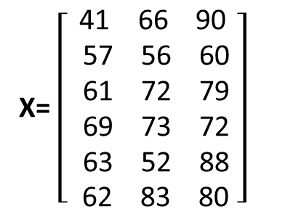
5. Principal Component Analysis : Application 1: Hidden factor, 4
# | SE OOP CI | Mean
1 2 3 4 5 6 | 41 66 90 57 56 60 61 72 79 69 73 72 63 52 88 62 83 80 | 65.7 57.7 70.7 71.3 67.7 75.0
How can table help in deriving hidden talent scores?
What is wrong with the average (see the table)?
Apply PCA to the data as is, no centering, to find the First singular triplet
X= $\left[\begin{aligned}\text{41 66 90} \\ \text{ 57 56 60} \\ \text{ 61 72 79} \\ \text{ 69 73 72} \\ \text{ 63 52 88} \\ \text{ 62 83 80} \end{aligned}\right]$
>> [Z,Mu,C]=svd(X);
>> z=Z(:,1) % First singular 6D scoring vector
>> Mu=Mu(1,1) % maximum singular value
>> ds=sum(sum(X.*X)) % data scatter
>> z = -z; c = -c;

Slide 18
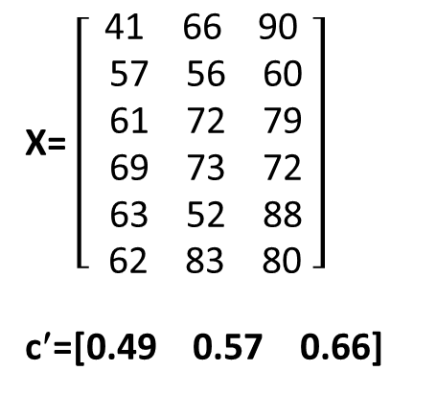
5. Principal Component Analysis : Application 1: Hidden factor, 5
# | SE OOP CI | Mean
1 2 3 4 5 6 | 41 66 90 57 56 60 61 72 79 69 73 72 63 52 88 62 83 80 | 65.7 57.7 70.7 71.3 67.7 75.0
How can table help in deriving hidden talent scores?
What is wrong with the average (see the table)?
Apply PCA to the data to find the First singular triplet
X= $\left[\begin{aligned}\text{41 66 90} \\ \text{ 57 56 60} \\ \text{ 61 72 79} \\ \text{ 69 73 72} \\ \text{ 63 52 88} \\ \text{ 62 83 80} \end{aligned}\right]$
c′=[0.49 0.57 0.66]
0.40
0.34
Z= 0.42
0.42
0.41
0.45
μ=291.39
X≈ μ z c′
How can one rescale z
to convert it to
0 – 100 scale?

Slide 19
5. Principal Component Analysis : Application 1: Hidden factor, 6
# | SE OOP CI | Mean
1 2 3 4 5 6 | 41 66 90 57 56 60 61 72 79 69 73 72 63 52 88 62 83 80 | 65.7 57.7 70.7 71.3 67.7 75.0
What is wrong with the average?
Apply PCA to the data to find the First singular triplet
How can one rescale z to convert it to
0 – 100 scale?
Use (*)-like equation Z=(.49*Se+.57*OOP+0.66*CI)∗α
Find α from OUR WISH that Z=100 at all subject marks being 100:
100=(.49*100+.57*100+0.66*100)∗α
α=100/[(.49+.57+.66)100]=0.5813
0.40
0.34
Z= 0.42
0.42
0.41
0.45
0.49
c = 0.57
0.66
μ=291.39
X≈μzc′
z=Xc/μ (*)

Slide 20
5. Principal Component Analysis : Application 1: Hidden factor, 7
# | SE OOP CI | Mean | PC z
1 2 3 4 5 6 | 41 66 90 57 56 60 61 72 79 69 73 72 63 52 88 62 83 80 | 65.7 57.7 70.7 71.3 67.7 75.0 | 68.0 57.8 71.5 71.5 68.9 75.8
What is wrong with the average?
Apply PCA to the data to find the First singular triplet
Rescale z to 0–100 scale
PCA: Z=(.49*Se+.57*OOP+0.66*CI)∗α
Found α=0.5813 from OUR WISH that Z=100 at all subject marks being 100. The FINAL equation:
Z=0.29*Se+0.33*OOP+0.38*CI
Mean=0.33*Se+0.33*OOP+0.33*CI

Slide 21
5. Principal Component Analysis : Application 1: Hidden factor, 8
# | SE OOP CI | Mean | PC z
1 2 3 4 5 6 | 41 66 90 57 56 60 61 72 79 69 73 72 63 52 88 62 83 80 | 65.7 57.7 70.7 71.3 67.7 75.0 | 68.0 57.8 71.5 71.5 68.9 75.8
What is wrong with the mean?
Mean=0.33*Se+0.33*OOP+0.33*CI,
Almost as good as the PCA factor; yet no contribution to the data scatter!
Hidden factor derivation:
1. Select base features and convert them into the same scale, say, 0 to 100, to form matrix X
2. Find the first singular triplet (μ, z, c)
3. Use equation z=Xcα to rescale z, typically to 0-100 scale, as explained
Z=0.29*Se+0.33*OOP+0.38*CI
4. Apply the equation to the used and new entities

Slide 22
5. Principal Component Analysis : Application 1: Hidden factor, 9
# | SE OOP CI | Mean | PC z
1 2 3 4 5 6 | 41 66 90 57 56 60 61 72 79 69 73 72 63 52 88 62 83 80 | 65.7 57.7 70.7 71.3 67.7 75.0 | 68.0 57.8 71.5 71.5 68.9 75.8
Interpretation:
Z=0.29*Se+0.33*OOP+0.38*CI
Weight of Se is lowered while Weight of CI is increased in comparison to the mean
All 4 of Iris dataset features relate to the specimen’s size.
Find hidden factor size for Iris.
Normalize features so that maximum gets a value of 100:
>>ma=max(iris);
>>X=iris*100./repmat(ma, 150, 1)
2. Find first singular triplet with positive loadings:
>>[z,mu,c]=svd(X);
>>c1=-c(:,1)
3. Determine factor α
>> alpha=1/sum(c);

Slide 23
5. Principal Component Analysis : Application 1: Hidden factor, 10
Interpretation:
All 4 of Iris dataset features relate to the specimen’s size.
Find hidden factor size for Iris.
Normalize features so that maximum gets a value of 100:
2. Find first singular triplet with positive loadings:
c1′= [0.58 0.53 0.46 0.42]
3. Determine factor α
>> alpha=1/sum(c); α=0.504
4. Compute the PCA hidden factor score vector
>>z= 0.29*SL+ 0.27*SW+ 0.23*PL+ 0.21PW
5. Determine its contribution to the data scatter
>>100*mu(1,1)^2/sum(sum(x.*x));% 94.05%

Slide 24
5. Principal Component Analysis : Application 1: Hidden factor, 11
Interpretation:
All 4 of Iris dataset features relate to the specimen’s size.
Loadings: this is what is interpreted first: c1′= [0.58 0.53 0.46 0.42]
All positive, even in spite that SL and SW correlate negatively.
Sepal sizes play here more important role that the petal sizes, by about (.58+.53)/(.46+.42)=1.26, 26%.
Also, the contribution is quite good: 94.05%
Also, compare the 50:50:50 distribution of Iris according to PCA with the taxa T1 T2 T3
z1 47 3 0
z2 3 40 7
z3 0 7 43, rather compatible!

Slide 25
5. Principal Component Analysis: Application 2: Data Visualization,1
How can one visualize a dataset X on a plane so that every entity is mapped to a 2D point according to the data structure?
Just take the two first singular triplets: this is the best 2D approximation of X possible.
Notes:
Mention that it is based on a model; usually considered a purely heuristic, thus much attractive; yet the model may be perceived as overly simplistic (a few did and rejected it). I still think that telling the truth is better than hiding it.

Slide 26
5. Principal Component Analysis: Application 2: Data Visualization,2
* =
Caveat. A figure showing the first PCA component before and after the data X is preprocessed into Y by centering, that is, subtracting the column means from the columns.
Red dots – raw data X
Blue – data Y centered
Circle – space origin
Red arrow – PC for X
Blue arrow – PC for Y
Because all PCs must go through the origin,
the data structure is better seen if it is looked at
against a backdrop of the means, that is, centered.

Slide 27
5. Principal Component Analysis: Application 2: Data Visualization, 3
* =
Procedure.
Center data into matrix Y by subtracting the column means from the columns; normalize if needed.
Compute two first singular triplets:
>> [Z,Mu,C]=svd(Y);
>> z1=z(:,1)*sqrt(Mu(1,1));
>> z2=z(:,2)*sqrt(Mu(2,2));% sqrt(Mu) to fit in the PCA model
3. Determine the proportion of the variance taken into account:
>> p=100*(Mu(1,1)^2+Mu(2,2)^2)/sum(sum(Y.*Y));
4. Visualize the data
>> plot(z1, z2, ‘k.’);
5. Interpret the axes by looking at the loadings and their signs.

Slide 28
5. Principal Component Analysis: Application 2: Data Visualization, 4
* =
Iris dataset example.
Center data into matrix Y by subtracting the column means from the columns.
>>Y=iris-repmat(mean(iris), 150, 1); % No normalization
Compute two first singular triplets:
>> [Z,Mu,C]=svd(Y);
>> z1=z(:,1)*sqrt(Mu(1,1));
>> z2=z(:,2)*sqrt(Mu(2,2));% sqrt(Mu) to fit in the PCA model
3. Determine the proportion of the variance taken into account:
>> p=100*(Mu(1,1)^2+Mu(2,2)^2)/sum(sum(Y.*Y)); % p=97.8%, good!

Slide 29
5. Principal Component Analysis: Application 2: Data Visualization, 5
* =
Iris dataset example.
4. Visualize the Iris data in two subplots, as a whole and taxon-wise.
>>subplot(1,2,1); plot(z1, z2, ‘k.’);
>>subplot(1,2,2);
>>plot(z1(1:50),z2(1:50),'g+',z1(51:100),z2(51:100),'ro',z1(101:150),z2(101:150),'bd');

Slide 30
5. Principal Component Analysis: Application 2: Data Visualization, 6
* =
Iris dataset example.
You must be creative at interpretation
5. Interpret the axes by looking at the loadings and their signs:
c1′= [ 0.3614 -0.0845 0.8567 0.3583]
c2′ = [ 0.6566 0.7302 -0.1734 -0.0755]
First PC: all components should be positive to express the size of iris. Unfortunately, c₂ is small negative (probably because the Sepal sizes correlate negative), and Petal Length component c₃ is much higher than the others. Still, arguably “specimen’s size”. Taxa ordered along.
Second PC: Sepal sizes high +, petal sizes low –. Arguably, “Sepal size short of petal size”. Has nothing to do with taxa.

Slide 31
5. Principal Component Analysis: Application 2: Data Visualization, 7
* =
Iris dataset example.
You must be creative at interpretation
5. Interpret the axes by looking at the loadings and their signs:
First PC z1: arguably “specimen’s size”. Taxa ordered along the axis on the drawing.
Define three classes in the ascending order z1:
>>[vz,iz]=sort(z1); pc{1}=iz(1:50); pc{2}=iz(51:100); pc{3}=iz(101:150);
Contingency table: T1 T2 T3
pc{1} 47 3 0 50 Indeed PC1, the “size”
pc{2} 3 40 7 50 works along taxa,
pc{3} 0 7 43 50 all errors among
50 50 50 150 neighbors

Slide 32
Week 5. Principal Component Analysis: Application 3: Dimension reduction with Latent Semantic Indexing, 1
Information retrieval :
Given a set of keywords, retrieve all the relevant documents
Example: Keywords “fuel & relief”
Merriam-Webster fuel
a material used to produce heat by burning
a source of sustenance or incentive
to give support or strength
relief
removal of something oppressive
a mode of sculpture
elevations of a land surface
Ambiguity: What meanings to pick?

Slide 33
Week 5. Principal Component Analysis: Application 3: Latent Semantic Indexing, 2
* =
Information retrieval :
Given a set of keywords, retrieve all the relevant documents
Example: Keywords “fuel & relief”
Merriam-Webster fuel
a material used to produce heat by burning
a source of sustenance or incentive
to give support or strength
relief
removal of something oppressive
a mode of sculpture
elevations of a land surface
LSI principle: “words used in the same contexts tend to have similar meanings”
is well caught with the SVD of document-to-keyword data

Slide 34
5. Principal Component Analysis: Application 3: Latent Semantic Indexing, 3
A database of 12×10 newspaper article-to-keyword items. Article labels: F for feminism, E for entertainment, and H for household. Problem: Properly retrieve articles using keywords
Article | drink equal fuel play popular price relief talent tax woman
F1 F2 F3 F4 E1 E2 E3 E4 H1 H2 H3 H4 | 1 2 0 1 2 0 0 0 0 2 0 0 0 1 0 1 0 2 0 2 0 2 0 0 0 0 0 1 0 2 2 1 0 0 0 2 0 2 0 1 2 0 1 2 2 0 0 1 0 0 0 1 0 3 2 1 2 0 0 0 1 0 2 0 1 1 0 3 1 1 0 1 0 1 1 0 1 1 0 0 0 0 2 0 1 2 0 0 2 0 1 0 2 2 0 2 2 0 0 0 0 0 1 1 2 1 1 0 2 0 0 0 1 0 0 2 2 0 2 0

Slide 35
5. Principal Component Analysis: Application 3: Latent Semantic Indexing, 4
Problem: Properly retrieve articles using keywords
Article | drink equal fuel play popular price relief talent tax woman
F1 F2 F3 F4 E1 E2 E3 E4 H1 H2 H3 H4 | 1 2 0 1 2 0 0 0 0 2 0 0 0 1 0 1 0 2 0 2 0 2 0 0 0 0 0 1 0 2 2 1 0 0 0 2 0 2 0 1 2 0 1 2 2 0 0 1 0 0 0 1 0 3 2 1 2 0 0 0 1 0 2 0 1 1 0 3 1 1 0 1 0 1 1 0 1 1 0 0 0 0 2 0 1 2 0 0 2 0 1 0 2 2 0 2 2 0 0 0 0 0 1 1 2 1 1 0 2 0 0 0 1 0 0 2 2 0 2 0
QUERY
Fuel
E1
E3
H1-H4
Precision=4/6=67%
Recall=4/4=100%
Fuel & Price
E3
H1-H4
Precision=4/5=80%
Recall=4/4=100%
No way to get 100% Precision by using crisp queries

Slide 36
5. Principal Component Analysis: Application 3: Latent Semantic Indexing, 5
Problem: Properly retrieve articles using keywords
Article | drink equal fuel play popular price relief talent tax woman
F1 F2 F3 F4 E1 E2 E3 E4 H1 H2 H3 H4 Query | 1 2 0 1 2 0 0 0 0 2 0 0 0 1 0 1 0 2 0 2 0 2 0 0 0 0 0 1 0 2 2 1 0 0 0 2 0 2 0 1 2 0 1 2 2 0 0 1 0 0 0 1 0 3 2 1 2 0 0 0 1 0 2 0 1 1 0 3 1 1 0 1 0 1 1 0 1 1 0 0 0 0 2 0 1 2 0 0 2 0 1 0 2 2 0 2 2 0 0 0 0 0 1 1 2 1 1 0 2 0 0 0 1 0 0 2 2 0 2 0 0 0 1 0 0 1 1 0 1 0
QUERY
Fuel Price Relief Tax
LSI:
Embed into a subspace of a few first singular triplets so that location of words relates to the similarity of contexts

Slide 37
5. Principal Component Analysis: Application 3: Latent Semantic Indexing, 6
TF-IDF normalization
TF = Term frequency, data entry
DF = Document frequency
N= Number of documents
IDF = Log(N/DF)
TF-IDF(F1,equal)=
2*0.88=1.76
Article | drink equal fuel play popular price relief talent tax woman
F1 F2 F3 F4 E1 E2 E3 E4 H1 H2 H3 H4 DF IDF Query | 1 2 0 1 2 0 0 0 0 2 0 0 0 1 0 1 0 2 0 2 0 2 0 0 0 0 0 1 0 2 2 1 0 0 0 2 0 2 0 1 2 0 1 2 2 0 0 1 0 0 0 1 0 3 2 1 2 0 0 0 1 0 2 0 1 1 0 3 1 1 0 1 0 1 1 0 1 1 0 0 0 0 2 0 1 2 0 0 2 0 1 0 2 2 0 2 2 0 0 0 0 0 1 1 2 1 1 0 2 0 0 0 1 0 0 2 2 0 2 0 5 5 6 7 7 8 5 6 4 5 0.88 0.88 0.69 0.54 0.54 0.41 0.88 0.69 1.10 0.88 0 0 0.69 0 0 0.41 0.88 0 1.10 0

Slide 38
5. Principal Component Analysis: Application 3: Latent Semantic Indexing, 7
2D LSI representation
One can see: With both normalizations,
Q is closer to H, whichever distance
is taken, Euclidean or Cosine
Specify LSI space dimension p
Pick first p singular triplets [Zp,Mp,Cp]
Visualize Zp∗Mp^{½}
Define
Q=Cp∗Mp^{-1/2}∗QUERY

Slide 39
5. Principal Component Analysis: Method, Model, Application
Summary
Theoretic introduction: Summarization versus Correlation: Summarization is similar to correlation if all features are considered target; the data standardization issue is important yet to be explored.
Matrix operations: Be cautious, matrices are not numbers!
Matrix spectrum, singular value decomposition, approximation: Considering a square matrix as a mapping, eigenvectors represent axes that are mapped onto themselves. For symmetric matrices these axes are mutually orthogonal. A rectangular matrix can be treated similarly if both direct and inverse mapping are considered. Luckily this amounts to multiplication of matrices and using one more, semi positive definite, property.
Notes:
Mention that it is based on a model; usually considered a purely heuristic, thus much attractive; yet the model may be perceived as overly simplistic (a few did and rejected it). I still think that telling the truth is better than hiding it.

Slide 40
5. Principal Component Analysis: Method, Model, Application
Summary
Hidden factor model. Its solution. Principal components, loadings, contributions. This all comes from the SVD theory because of somewhat over simplistic character of the model, just a product of row-related item and a column-related item.
Conventional PCA criterion and method. Relation between the model-based and conventional approaches. Covariance and correlation matrix. Amazingly, the covariance and correlation matrices are closely related to a matrix of direct-inverse mapping, which provides for getting the same results. Yet the model-based criterion has a number of good properties that are going to be used next week.
Notes:
Mention that it is based on a model; usually considered a purely heuristic, thus much attractive; yet the model may be perceived as overly simplistic (a few did and rejected it). I still think that telling the truth is better than hiding it.

Slide 41
5. Principal Component Analysis: Method, Model, Application
Summary
Finding a hidden factor with PCA: No feature centering, though a normalization to 0-100 scale may be advisable; both contribution to data scatter and interpretation can be of interest.
Data visualization with PCA: Feature centering is a must to present the data structure against the center’s backdrop; both contribution to data scatter and interpretation can be of interest.
Notes:
Mention that it is based on a model; usually considered a purely heuristic, thus much attractive; yet the model may be perceived as overly simplistic (a few did and rejected it). I still think that telling the truth is better than hiding it.

Slide 42
5. Principal Component Analysis: Method, Model, Application
Summary
Latent Semantic Indexing: Effectively addressing the word polysemy problem for Information Retrieval with PCA by shifting from crisp interpretations to soft Euclidean or Cosine distances; simultaneously reduces dimesion from thousands to hundreds.
Many more applications exist, first of all, in signal and image compression.
Notes:
Mention that it is based on a model; usually considered a purely heuristic, thus much attractive; yet the model may be perceived as overly simplistic (a few did and rejected it). I still think that telling the truth is better than hiding it.

Slide 43
Homework 4: PCA/SVD
In your data set, select a subset of 3-6 features related to the same aspect and explain your choice
Standardize the selected subset; compute its data scatter and determine contributions of all the principal components to the data scatter, naturally and per cent
Visualize the data with these features using standardization with two versions of normalization: (a) over ranges and (b) over standard deviations. At these visualizations, use a distinct shape/colour for points representing a pre-specified by you group of objects. Also, apply the conventional PCA for the visualization and see if there is any difference. Comment on which of the normalizations is better and why.
Compute and interpret a hidden factor behind the selected features. The factor should be expressed in a 0-100 rank scale (as well as the features).

